Slide 1
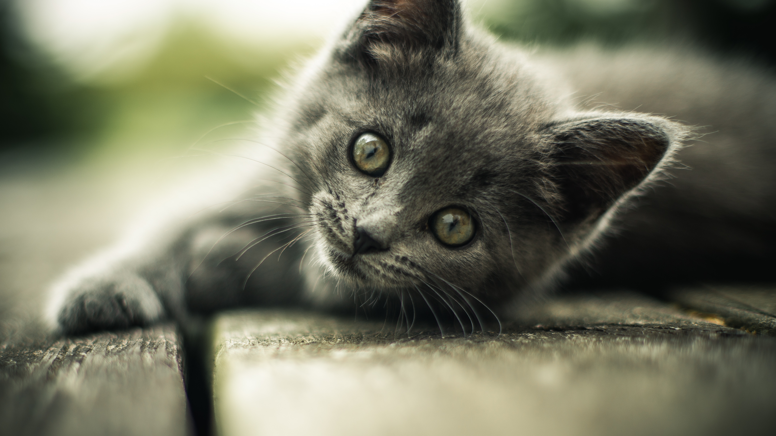
Digital Cats and Analog Cows

Slide 2
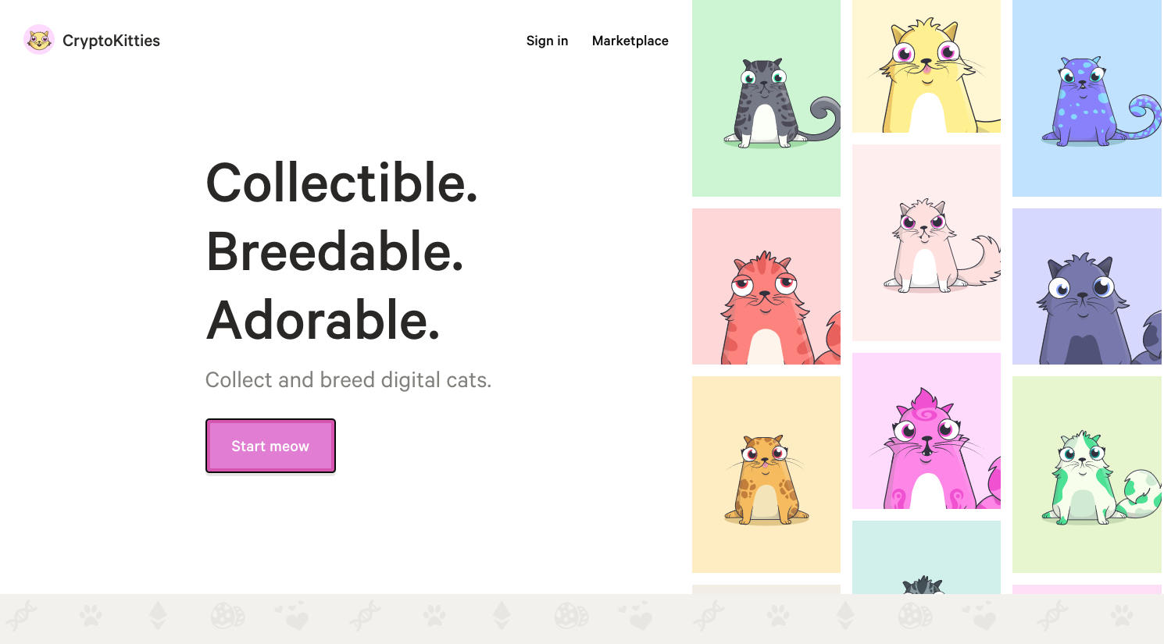

Slide 3
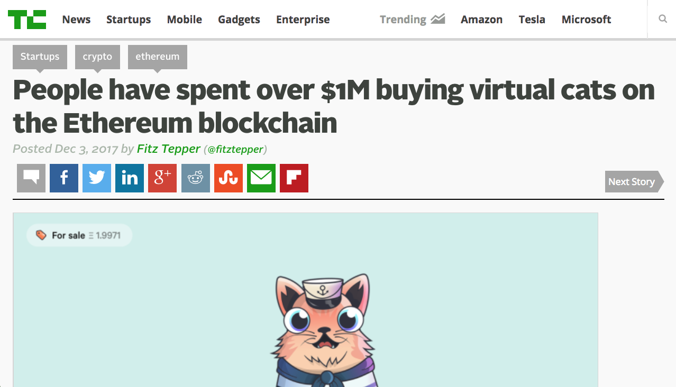

Slide 4
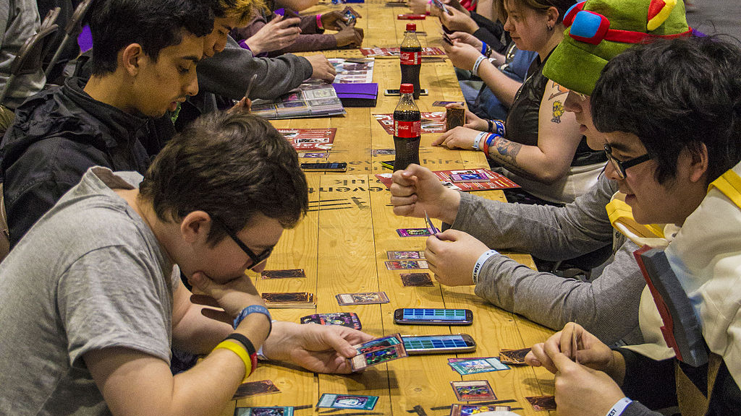
Collectible Card Games

Slide 5

More to it!

Slide 6



Slide 7
First Mainstream Dapp

Slide 8
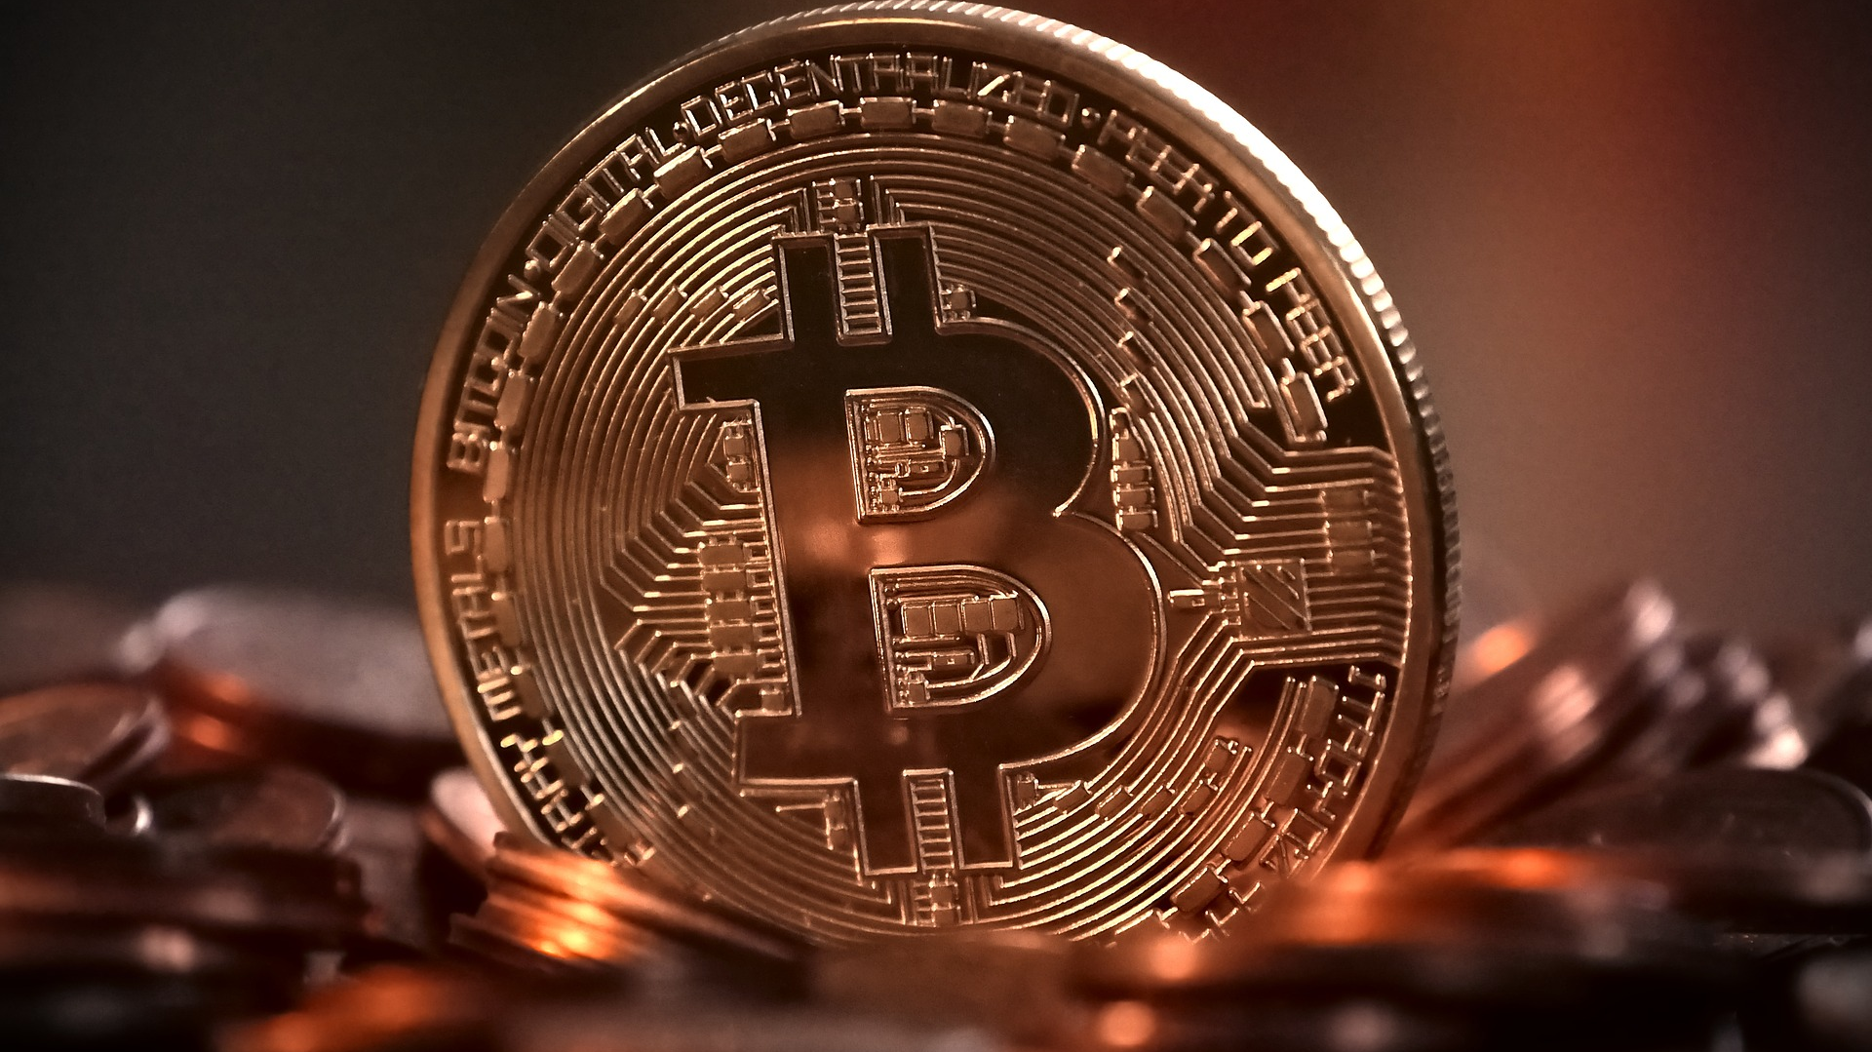
ICOs and other Contracts

Slide 9
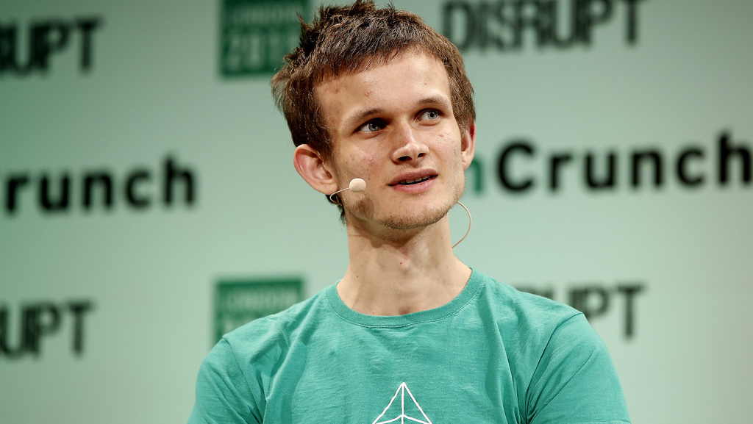
Vitalik founded etherium out of frustration

Slide 10
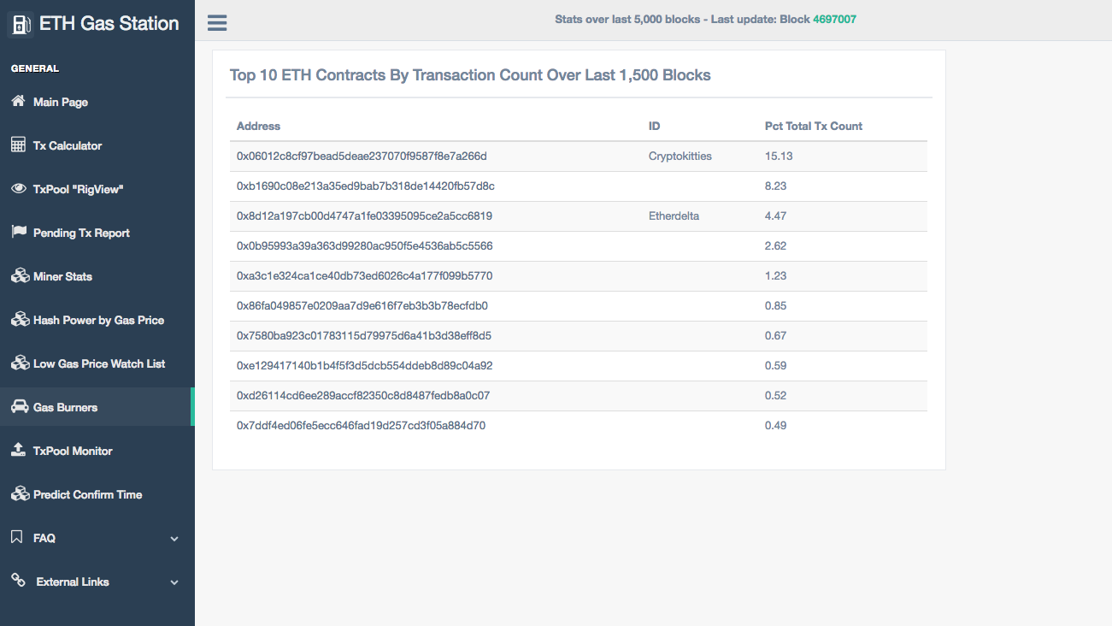
Slowed from 12 sec/transaction to 33 sec/transaction

Slide 11
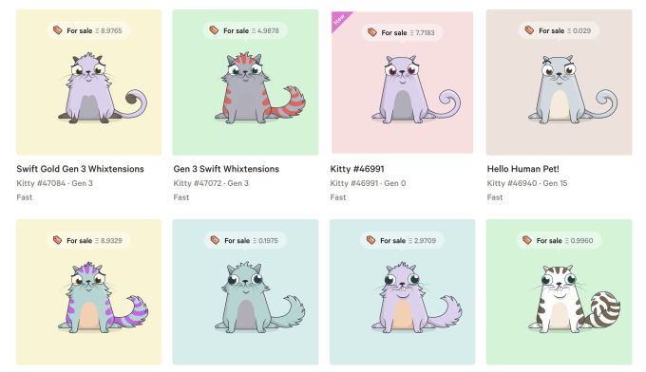
How it works: kitties purchase screen

Slide 12
How it works
100 founder kitties
New Gen 0 cats, every 15 mins
Price, average last 5 sold + 50%
Anyone can sell in auction
New cats by breeding
256 Genome: color, cooldown time, whiskers, etc. – some recessive
Each time you breed generation increases by 1
Very valuable

Slide 13
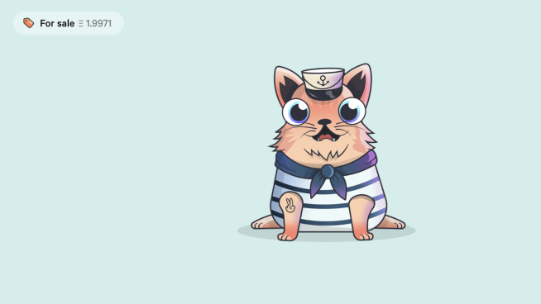
You own it
(no one can take away from you)
CryptoKitties Image

Slide 14

Big deal for games
New Deal For Games

Slide 15

100 Billion Industry – Next Gen?
A new generation of blockchain games

Slide 16
ICO 2.0?

Slide 17
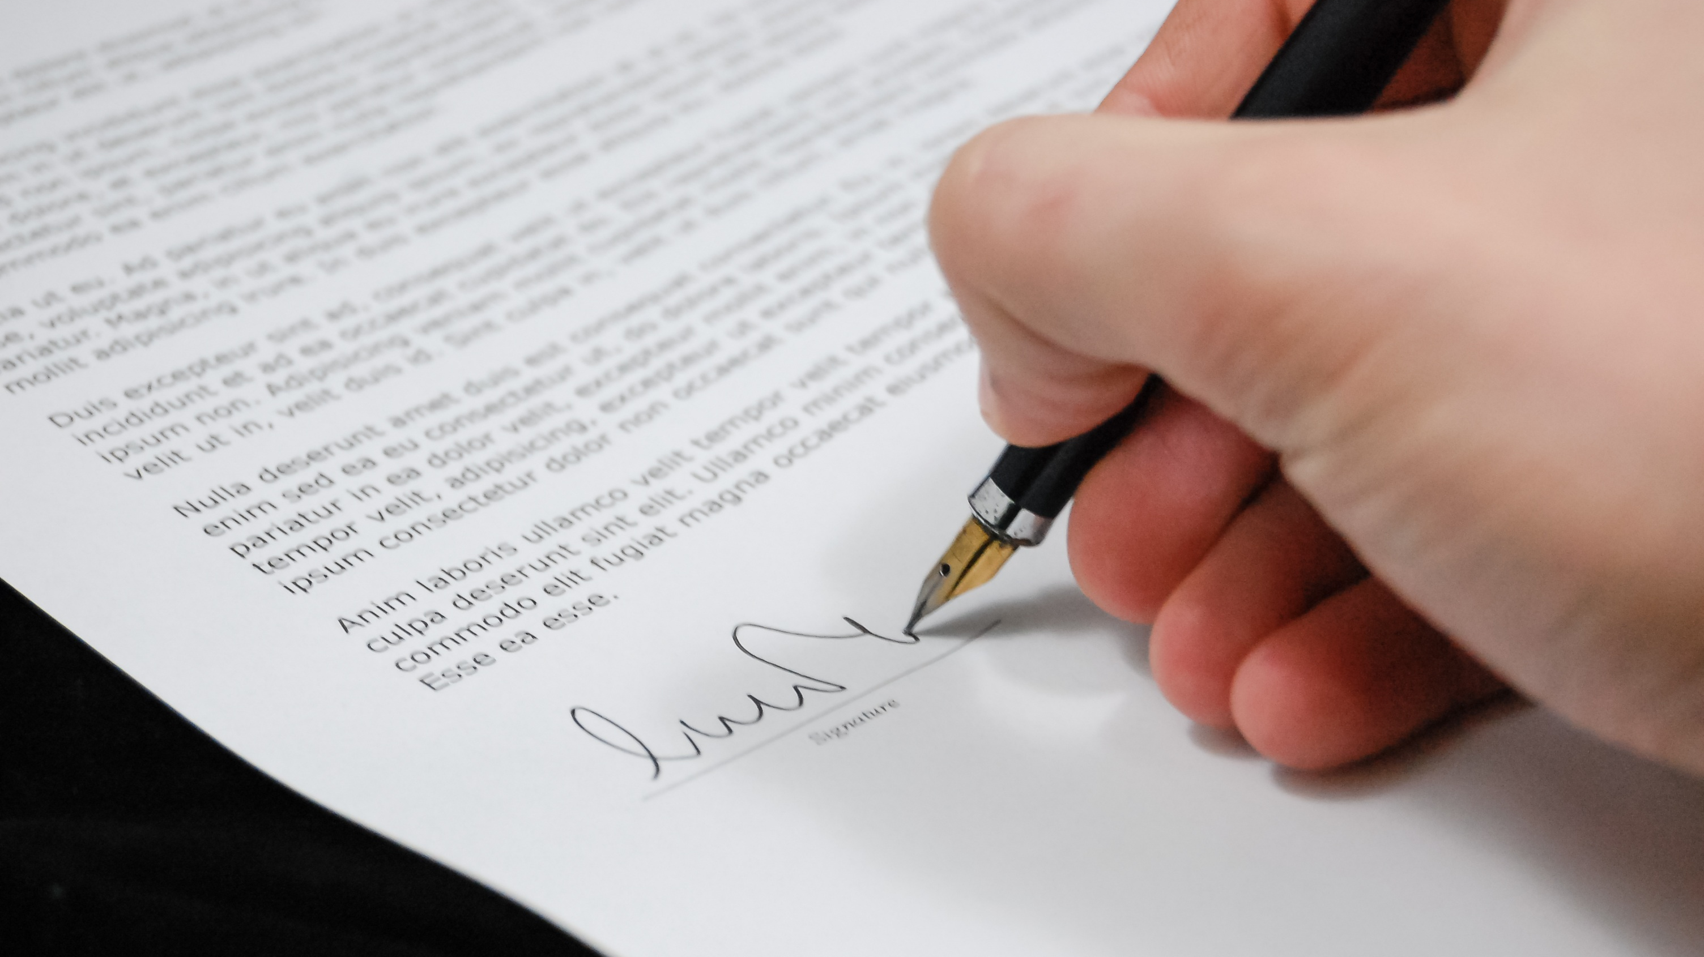
A Great Way to Debug Contracts

Slide 18

First time, game cannot be changed by owner

Slide 19
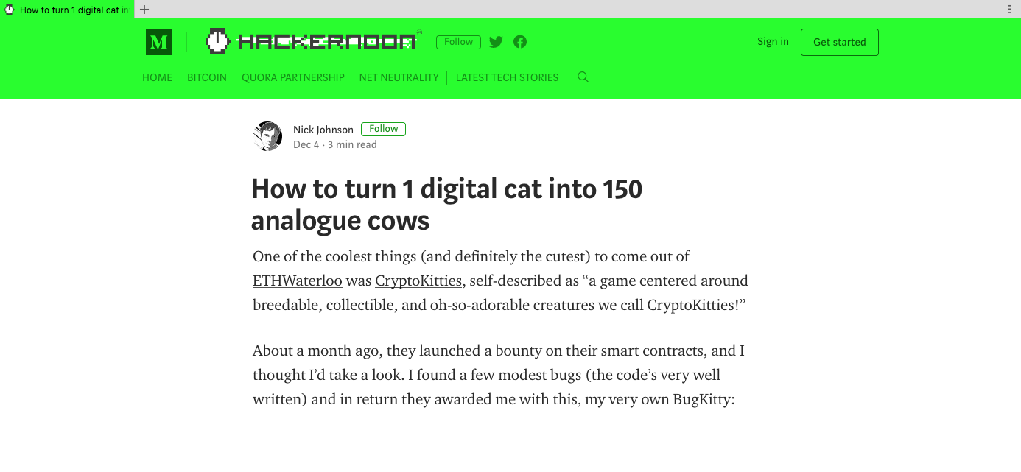
How to turn 1 digital cat into 150 analogue cows

Slide 20
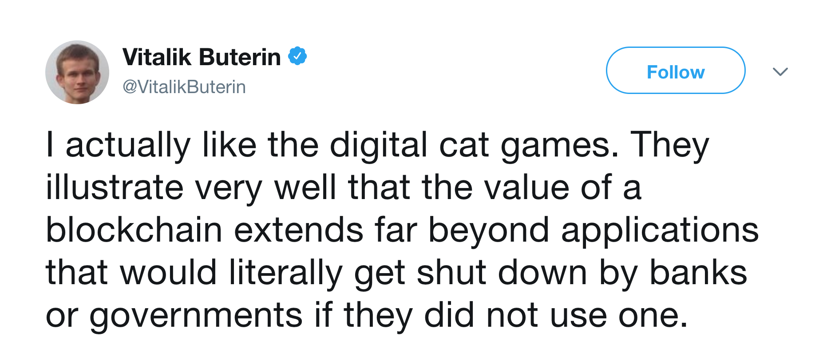

Slide 21

Good Case Study

Slide 22
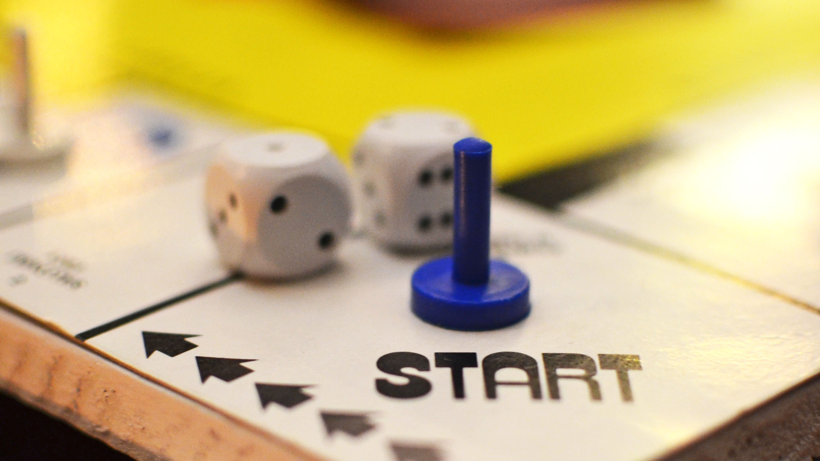
Closing comments, could be a very big deal!

